Slide 1

Nasa Space Apps Challenge
BioSpace Search Engine
Build a Space Biology Knowledge Engine

Slide 2


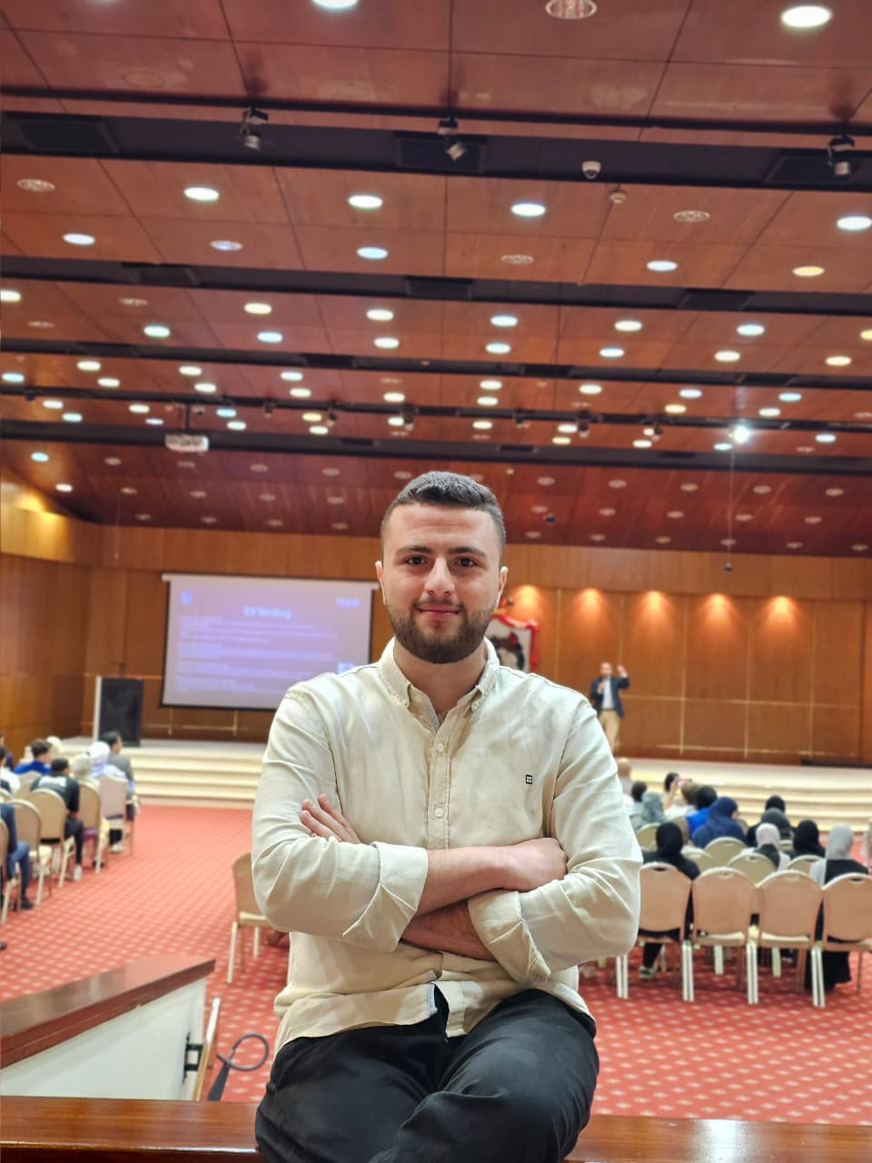

MEET THE TEAM
Abdul Rahman Osaili
Ahmad Jumah
Shafea Abu Snenih
Ahmad Almashaikh
Rama Qazaqi
Lamar Abu Daoud

Slide 3

1) Scattered Knowledge
2) Hard Access
WHAT IS THE PROBLEM
3) No Personalization
4) Slow Progress

Slide 4

1)
Quickly find the exact research or data you're looking for.
2)
Create concise, clear, summarized data that appeal to all user levels with AI.
3)
Collect and organize NASA life sciences information in one place.
OUR
SOLUTION

Slide 5
1
2
3
4
We used API to download NASA provided data
We did data preprocessing and data analytics
We uploaded them to LLM to get searching helpers
We built a web page to search and present the results
WORKFLOW DIAGRAM

Slide 6
More Data
Bigger Servers
Huge LLMs
SCALABILITY
We can improve our solution be providing:

Slide 7
Thank you

